Slide 1

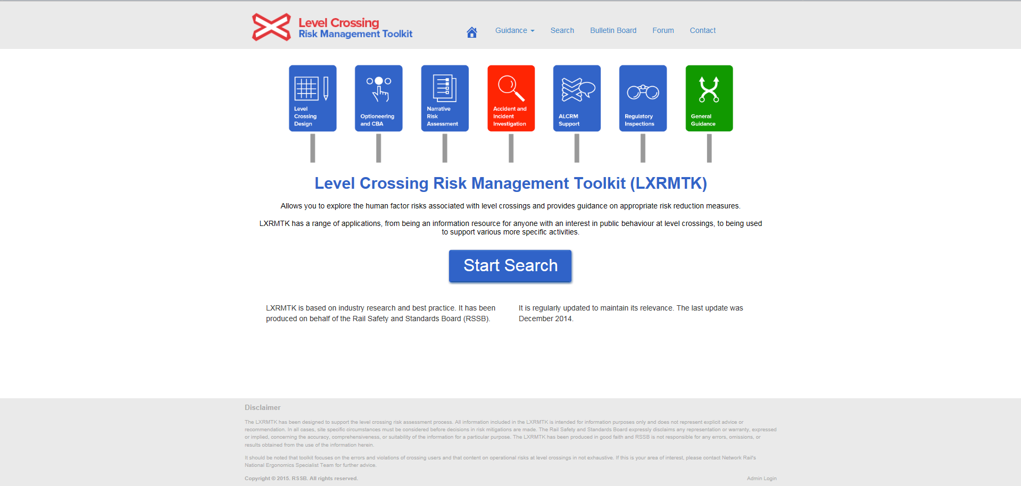
Introduction Training

Slide 2
Training contents
Introduction
What is LXRMTK?
How can LXRMTK be used?
Where can LXRMTK be used?
Who can use LXRMTK?
History of LXRMTK
LXRMTK site navigation
Using the search function
Search location
Selecting RIFs or MMs
Filter your search
Filter options – RIFs
Filter options – MMs
Sort results
Select a result
View a result
Export your results
Leaving comments on Mitigation Measures

Slide 3
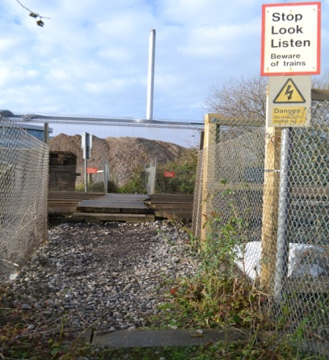
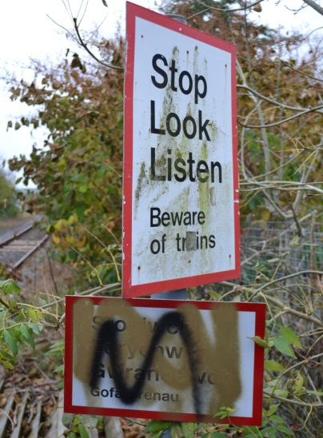
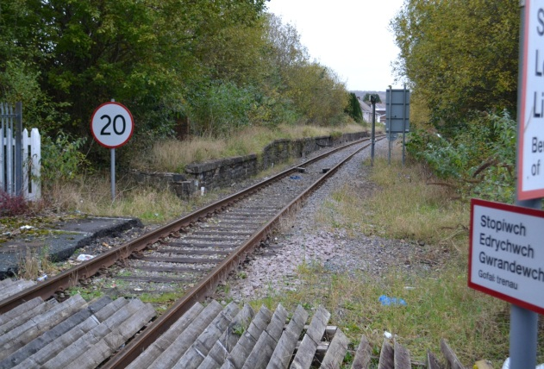
Introduction: What is LXRMTK?
The Level Crossing Risk Management Toolkit (LXRMTK) is a web-based database that:
Promotes a performance-based understanding of road user errors and violations at level crossings
Enables the systematic evaluation of human factors issues/risk influencing factors at level crossings
Supplies practical guidance on the selection of appropriate risk mitigation measures at level crossings
Provides an audit trail for any decisions made regarding the implementation of risk reduction measures and supports the cost benefit analysis process.

Slide 4
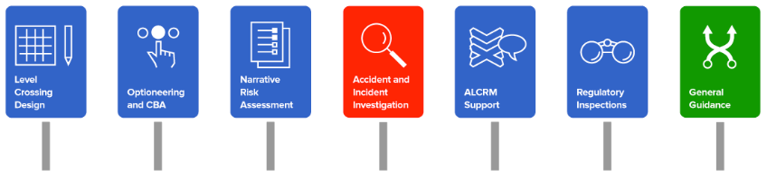
Introduction: How can LXRMTK be used?
A general info resource for Level Crossing Managers
  A central store for the knowledge and experience in LX management
  Content is peer reviewed, provides an audit trail and is based upon research and best practice
A practical field guide to LX risk assessment
  To identify (and even pdf and save on iPad) a checklist of potential issues to be aware of/look out for before going out to site and to guide thinking during risk assessments
  To aid optioneering – identify measures that are actually likely to have an impact on the specific user behaviours identified/likely at the crossing based on understanding of site characteristics and user profiles
  To assist with Narrative Risk Assessments – to guide thinking, provide evidence for influencing factors and key risks associated with different crossing and user types, to give background detail and an audit trail for decisions made etc

Slide 5
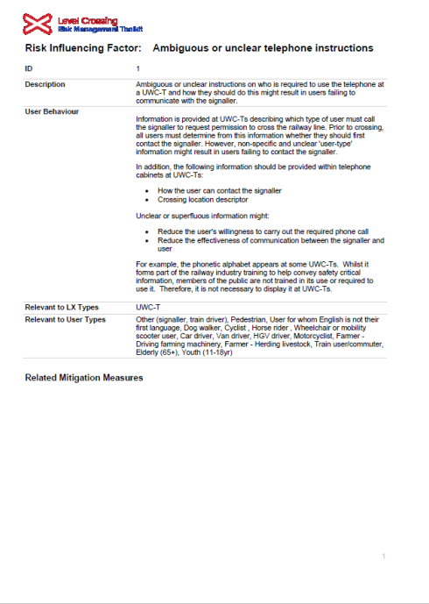
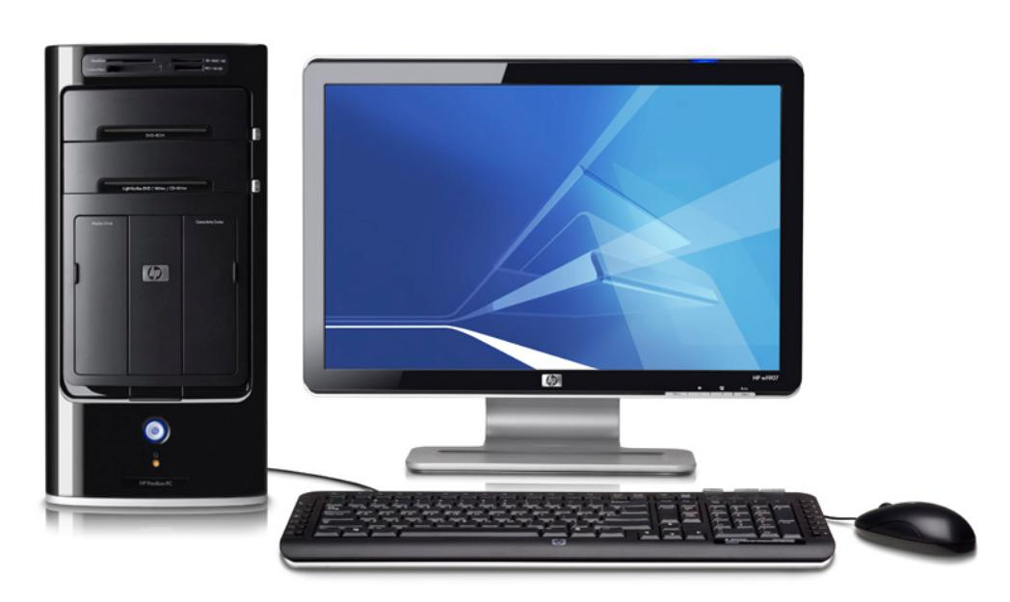
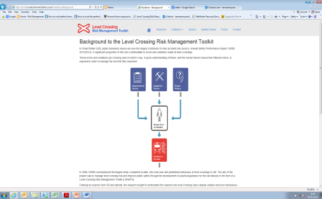

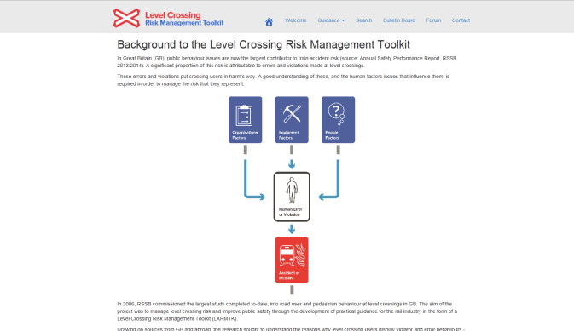
Introduction: Where can LXRMTK be used?
Desktop computers
Tablet computers (with an internet/WiFi connection)
Hardcopy - print the results onto paper so they can be used at locations where there is no internet access.

Slide 6






Introduction: Who can use LXRMTK?
Anyone who has an interest in risk at level crossings!
LXRMTK has a range of applications, from being an information resource for anyone with an interest in public behaviour at level crossings, to being used to support various more specific activities conducted by industry.
In particular, the following people may find the LXRMTK to be useful:
Level Crossing Managers (LCMs) (Network Rail)
Route Level Crossing Managers (RLCMs) (Network Rail)
Operations Managers (Network Rail)
Office of Rail Regulation (ORR)
Accident/Incident Investigators (Rail Accident Investigation Branch (RAIB), Network Rail, Rail Safety and Standards Board (RSSB))
External consultants
Level crossing designers

Slide 7
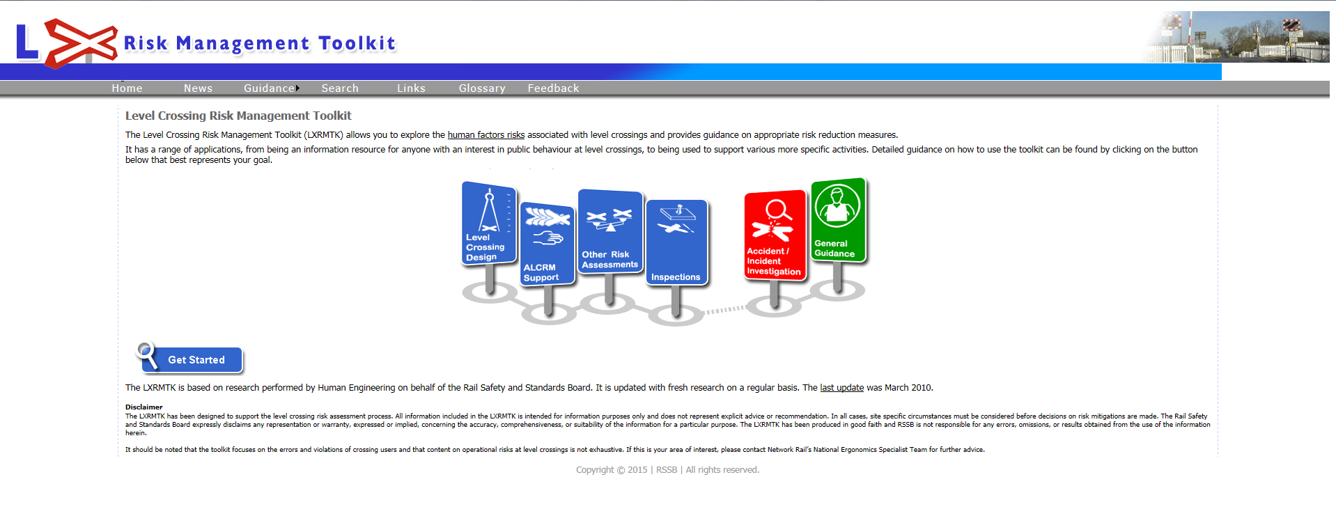
Introduction: History of LXRMTK
The LXRMTK was the result of RSSB research (T335, 2005) into road user behaviour at level crossings.
Drawing on sources from the UK and abroad, the research sought to understand the reasons why level crossing users make errors and violations at crossings, and why and how these lead to accidents.
  LXRMTK was created in collaboration with subject matter experts in level crossing risk management from Network Rail and launched in 2006, hosted at: www.lxrmtk.com

Slide 8
Introduction: History of LXRMTK
RSSB T1053: Revised content
Increased filtering capabilities
RSSB T1053: New, enhanced functionality
Improved user interface
Flexible search capability
Revised RIFs
Revised MMs
Consolidated guidance
Training slides
Updated homepage, links and guidance
Sort results by ‘most viewed’
Intelligent keyword search
Export to PDF and email an MS Word document
MM comments function
  Since 2006, there have been a number of relatively minor updates (2008, 2010 & 2014) as well as a more fundamental overhaul in 2015 (RSSB, T1053) to reflect:
  Approach to level crossing risk management, procedures, responsibilities
  Latest research and best practice from GB and abroad
  Incident investigation recommendations
  New and innovative technologies in development and in testing
  End user feedback.

Slide 9
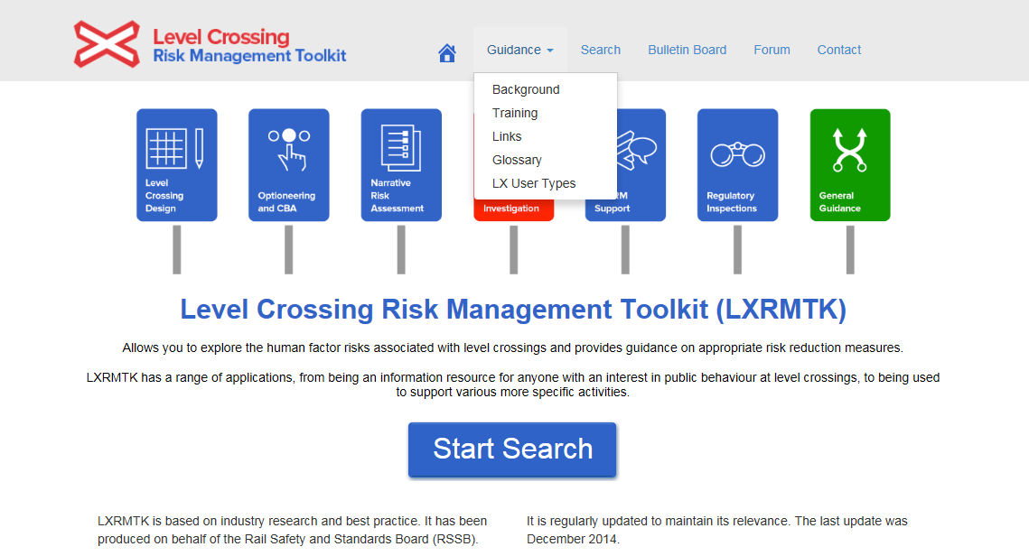

LXRMTK site navigation
LXRMTK toolbar:
The Guidance pages provide you with information on:
background to LXRMTK;
a link to these training slides;
links to relevant websites, e.g. regulators and campaigns;
glossary of terms and abbreviations;
information on the LX user types considered in LXRMTK.
The Search function allows you to search, discover and learn about the different risk influencing factors and mitigation measures that could be associated with a specific level crossing and its context. This function will be discussed further in the next part of this training.
The Bulletin Board provides information on the latest updates to LXRMTK.
The Forum links to Network Rail’s internal discussion forum. This is for use by Network Rail employees only.
The Contact page provides a feedback capability for any comments or queries related to LXRMTK.

Slide 10
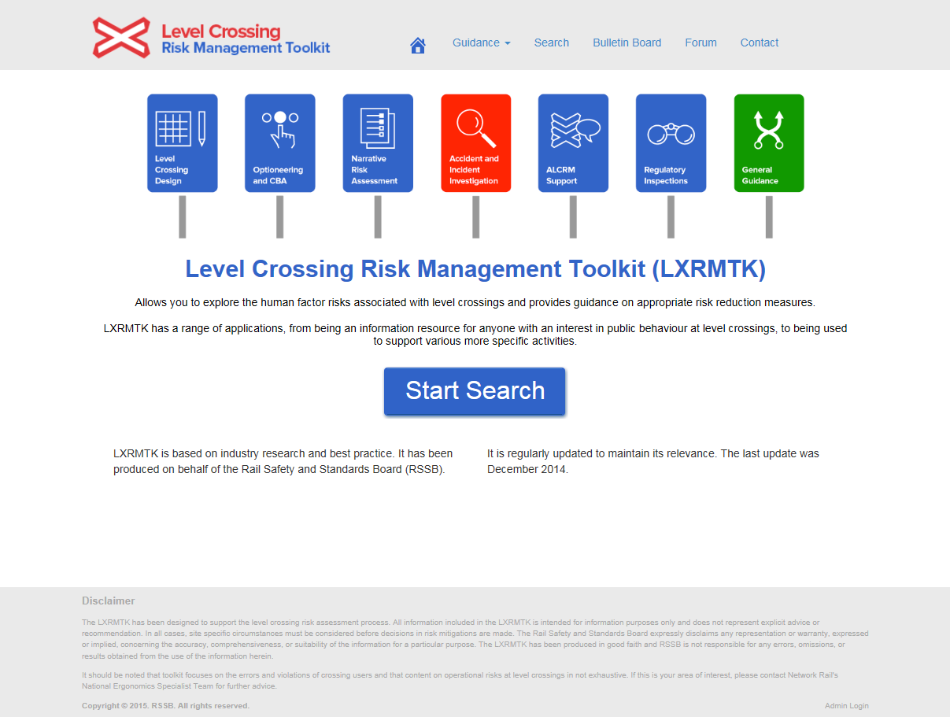
Using the search function: Search location
The search function can be accessed either via the top toolbar, or the button on the homepage.

Slide 11
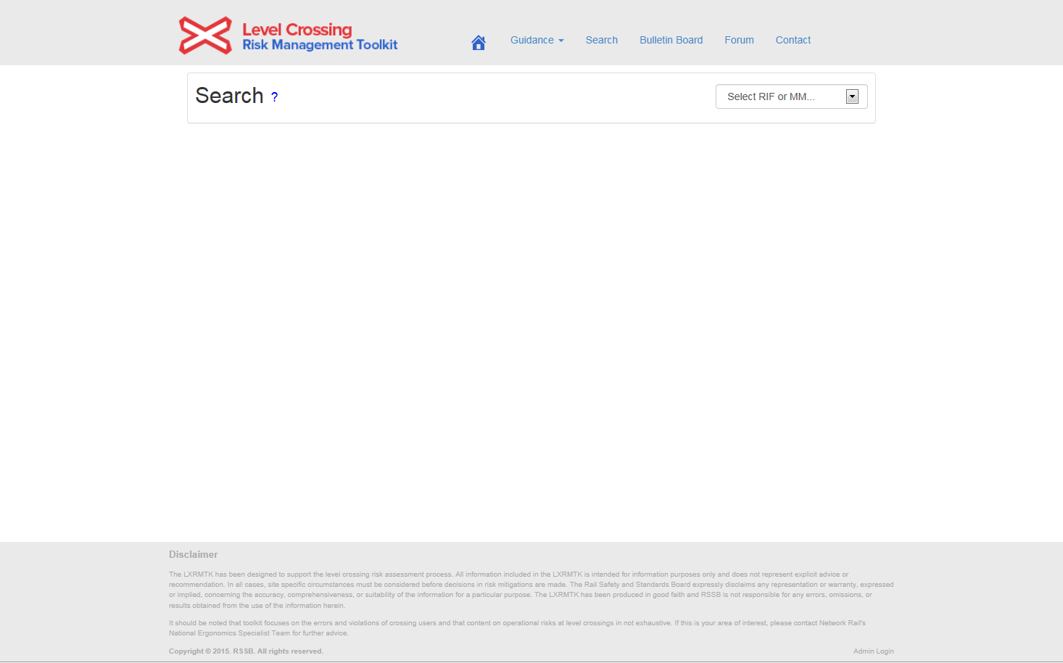

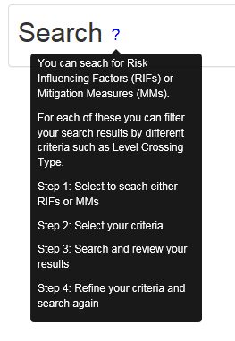
Using the search function: Selecting RIFs or MMs
First, Select whether you would like to search for:
the risk influencing factors (RIFs) that might be associated with your level crossing,
or
potential mitigation measures (MMs) that can be implemented at your level crossing.
Select whether you would like to search for Risk Influencing Factors (RIFs) or Mitigation Measures (MMs).
Note: hovering your cursor over the ‘tooltips’ ? on any page will reveal guidance for that webpage

Slide 12
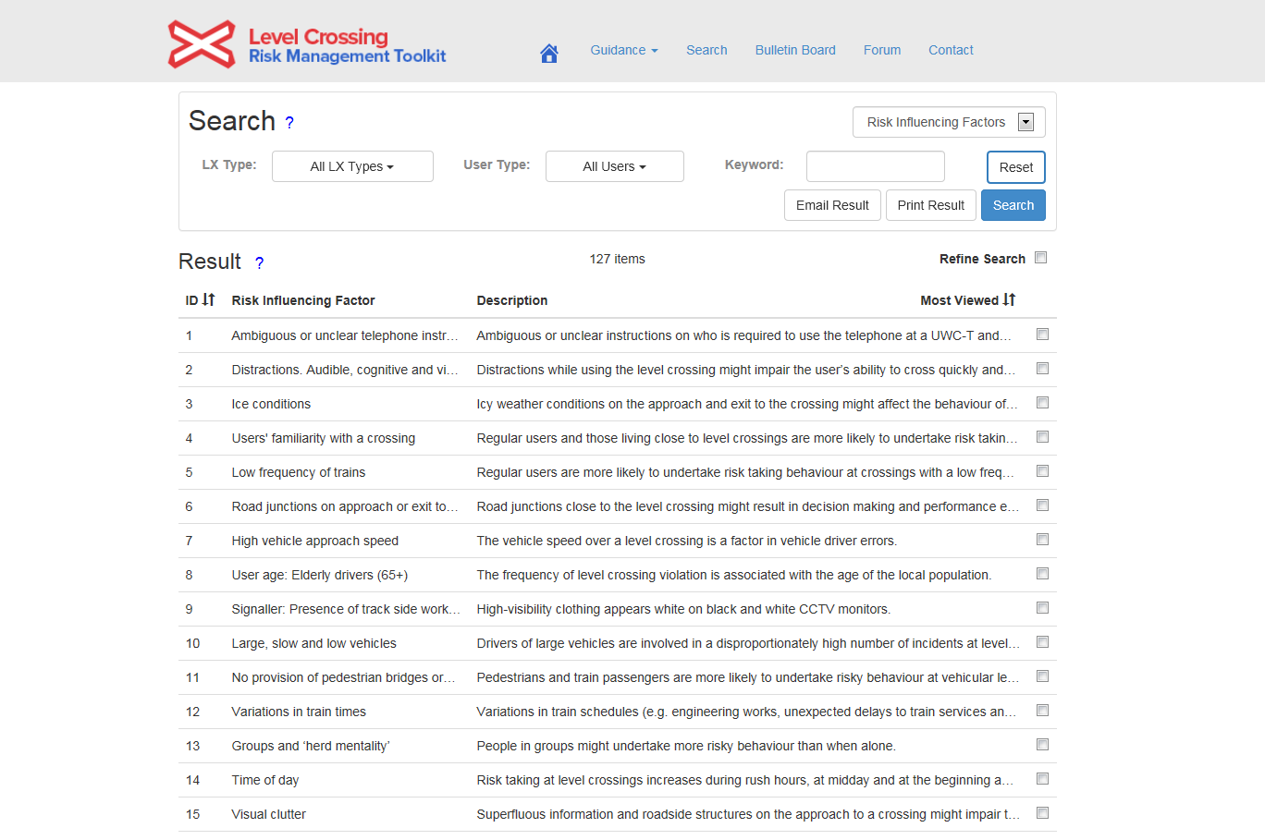
Using the search function: Filter your search
Filter and refine:
your results as required using the various options for both RIFs and MMs.
You can also select multiple options within the filters to refine your results further…
Filter your search as required using the different options…
Add a keyword for specific searches…
See the number of results that your filtering produces.

Slide 13
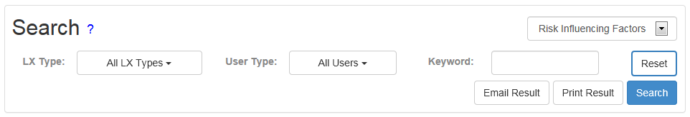
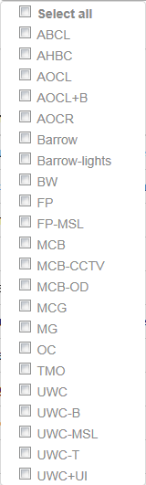
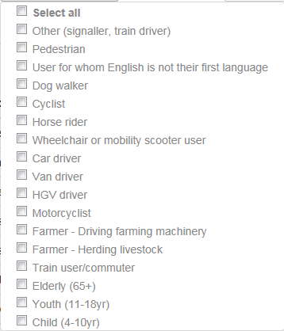
Using the search function: Filter options - RIFs
Filter options for RIFs…
Filter options for RIFs…
Filter options for RIFs…

Slide 14
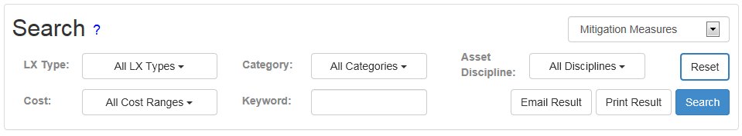

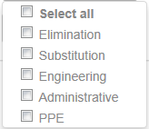
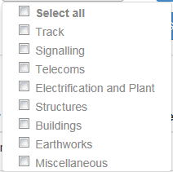
Using the search function: Filter options - MMs
Filter options for MMs…
Filter options for RIFs…
_{Filter options for RIFs…}
_{Filter options for RIFs…}
Filter options for RIFs…

Slide 15
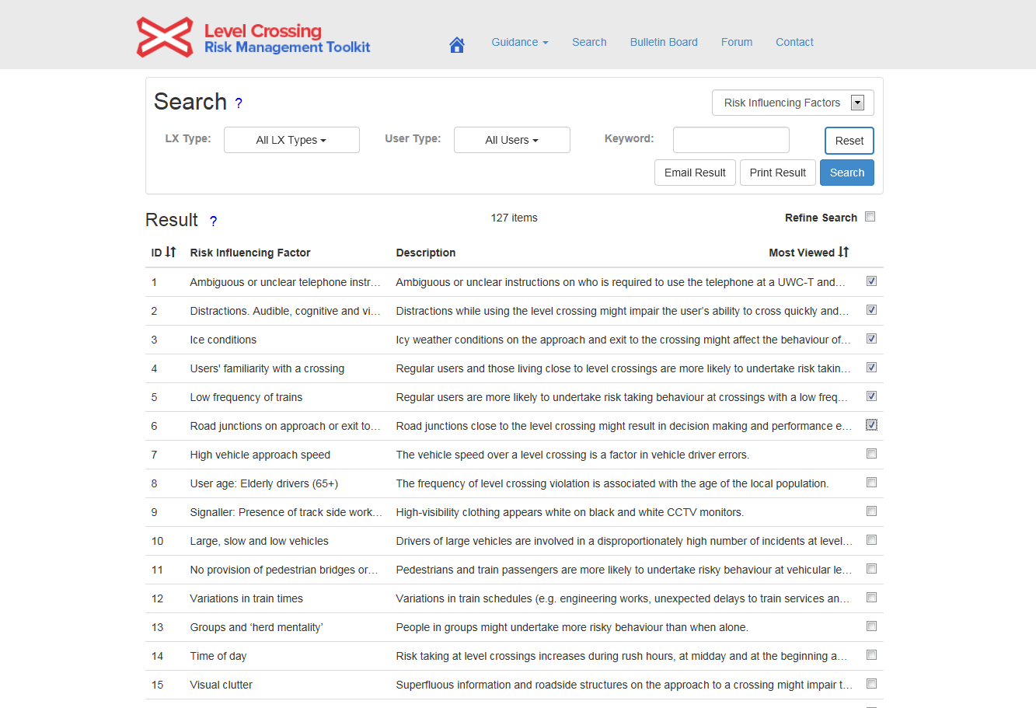
Using the search function: Filter your search
Filter and refine:
Once you have filtered your results as much as possible using the drop down lists, you can refine them further if needed by selecting those that are relevant and then clicking ‘Refine Search’.
Select all of the results that are relevant to your level crossing…
Click on ‘Refine Search’ to reduce the results.

Slide 16
Using the search function: Sort results
Sort your results by clicking on the arrows next to a heading – MMs can be sorted by ‘ID’, ‘Category’, ‘Cost’ and ‘Most Viewed’, and RIFs by ‘ID’ or ‘Most Viewed’.

Slide 17
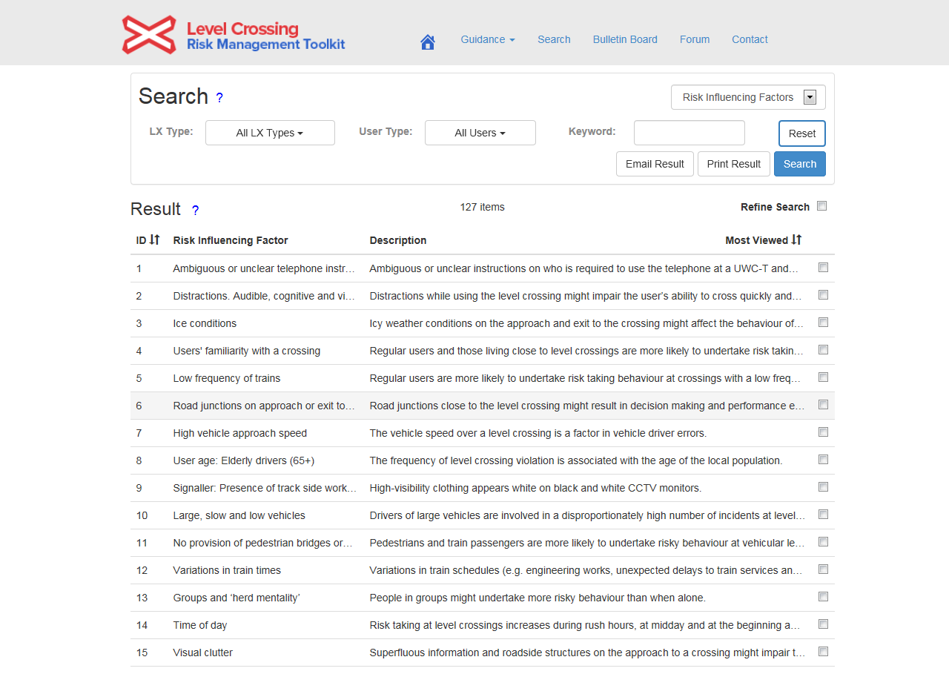
Using the search function: Select a result
Select the result that you would like to view.

Slide 18
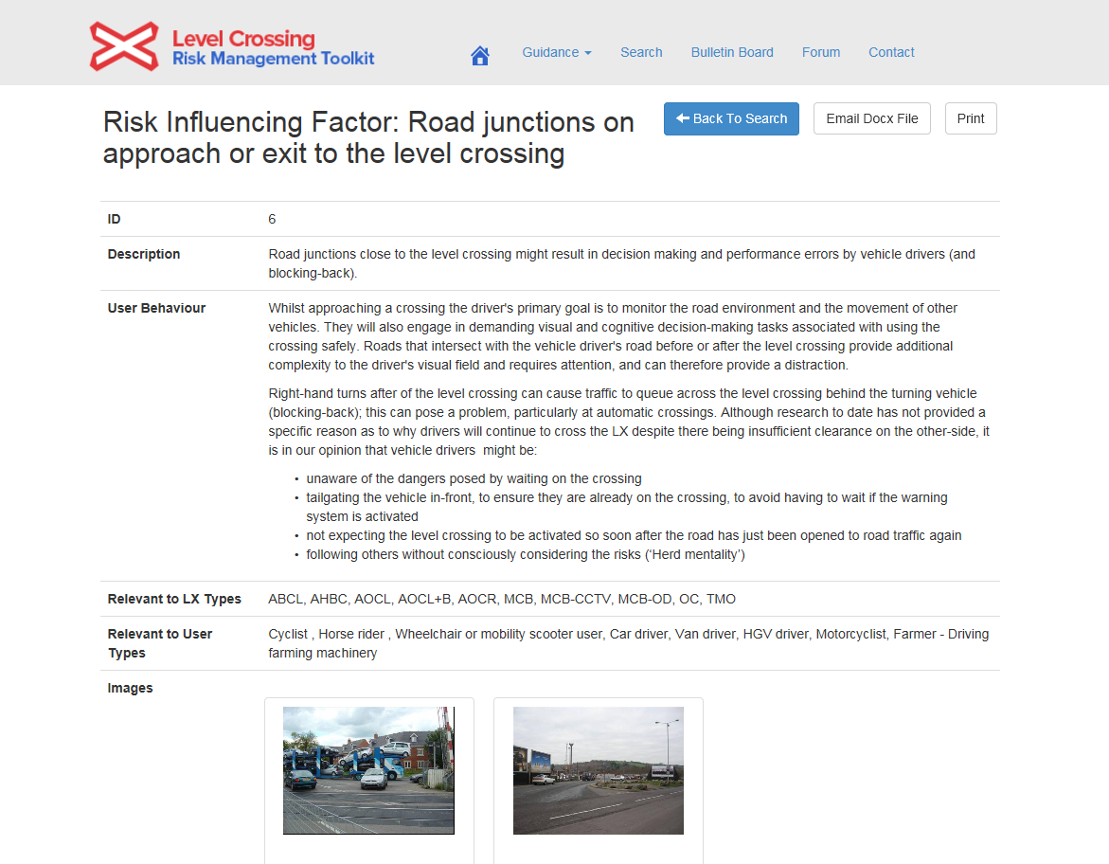
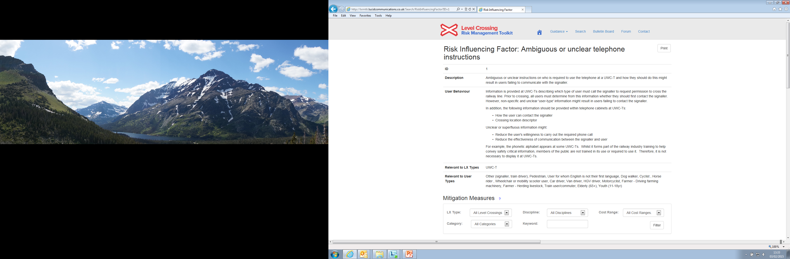
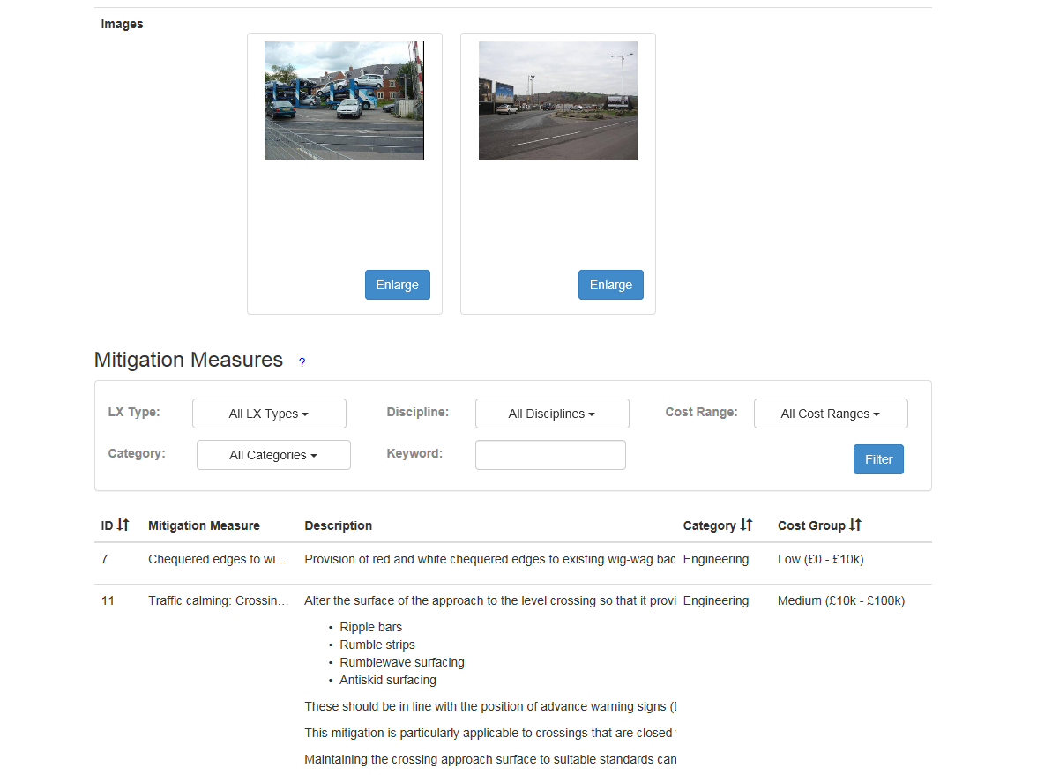
Using the search function: View a result
Scroll down to see the associated MMs to your RIF, or if you are within an MM entry, scroll down to see the associated RIFs…
Click back if you would like to return to your results…
Enlarge the associated images to see them clearly…
Filter the associated MMs as required…
The RIF will remain visible as you refine the MMs that are associated with it.

Slide 19
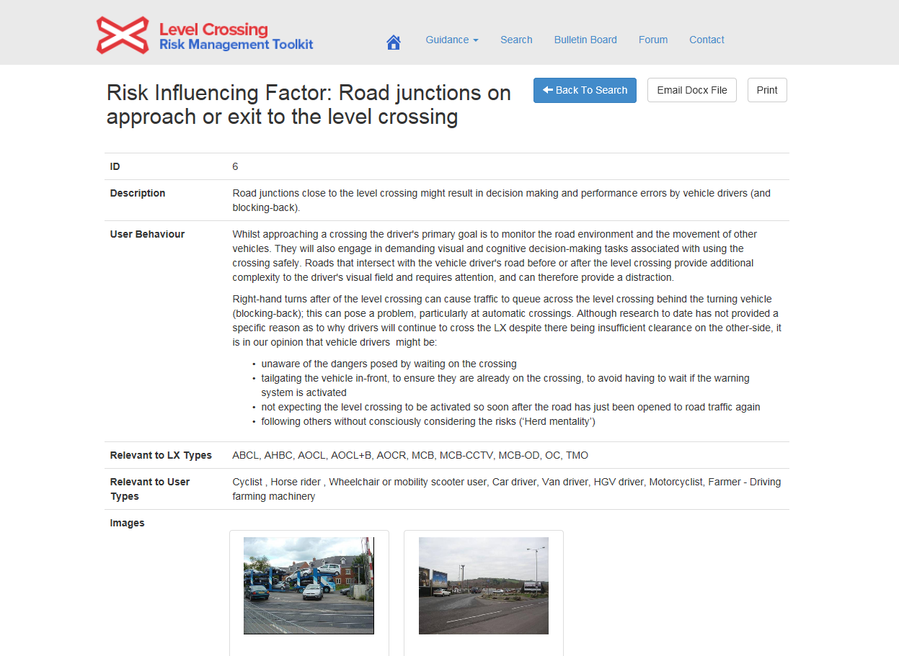
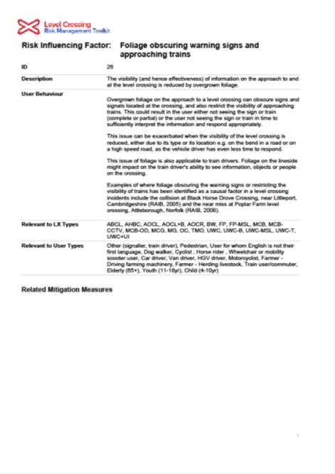
Using the search function: Export your results
Export your search results by:
emailing your result as a Microsoft Word document to yourself or another person to enable you to add comments
printing to PDF (e.g. relevant RIFs) for use offsite or printing to paper.

Slide 20
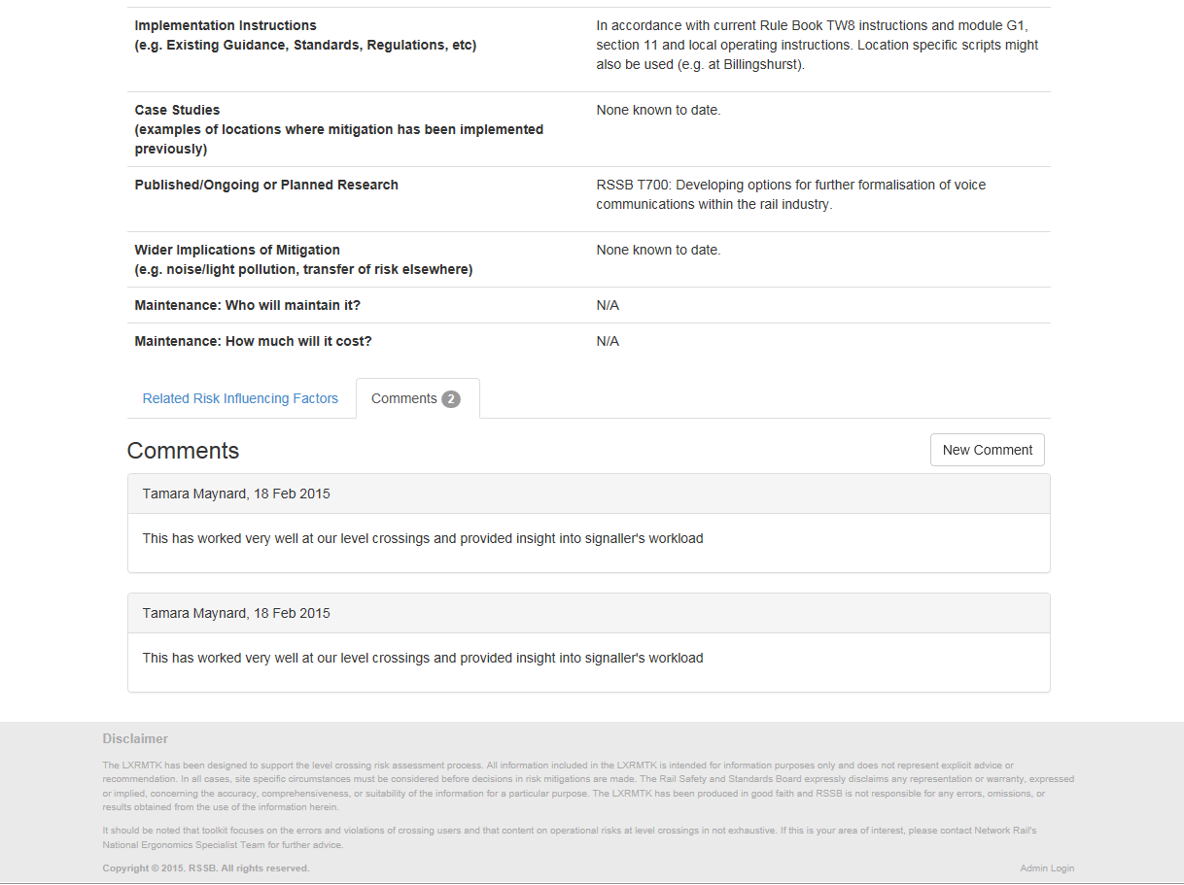
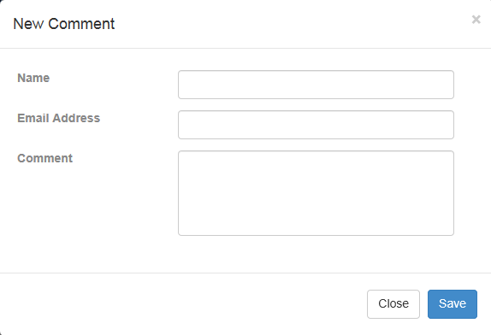
Leaving comments on Mitigation Measures
Comment on the mitigation measures with any real-world information/ case studies you may have, including:
benefits and any issues
implementation requirements
maintenance requirements
costing information.
Your comments will provide support to other users looking to implement mitigation measures and help to inform future updates to LXRMTK.
Please ensure your comments are relevant and appropriate. Comments will be moderated by Network Rail prior to being uploaded and feedback provided where necessary.
Within a MM, scroll down and select the comments page next to the related RIFs.

Slide 21
End of training

